Slide 1
Duct tape projects
Because every camp needs some duct tape!

Slide 2

Duct tape headband

Slide 3

Duct tape flowers

Slide 4

Duct tape wallet

Slide 5
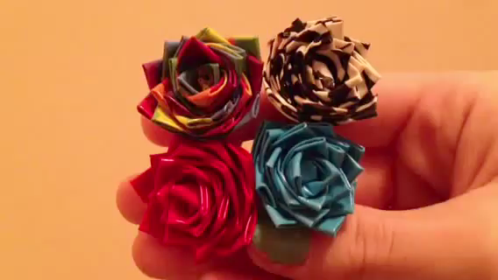
Duct tape flower rings

